Slide 1
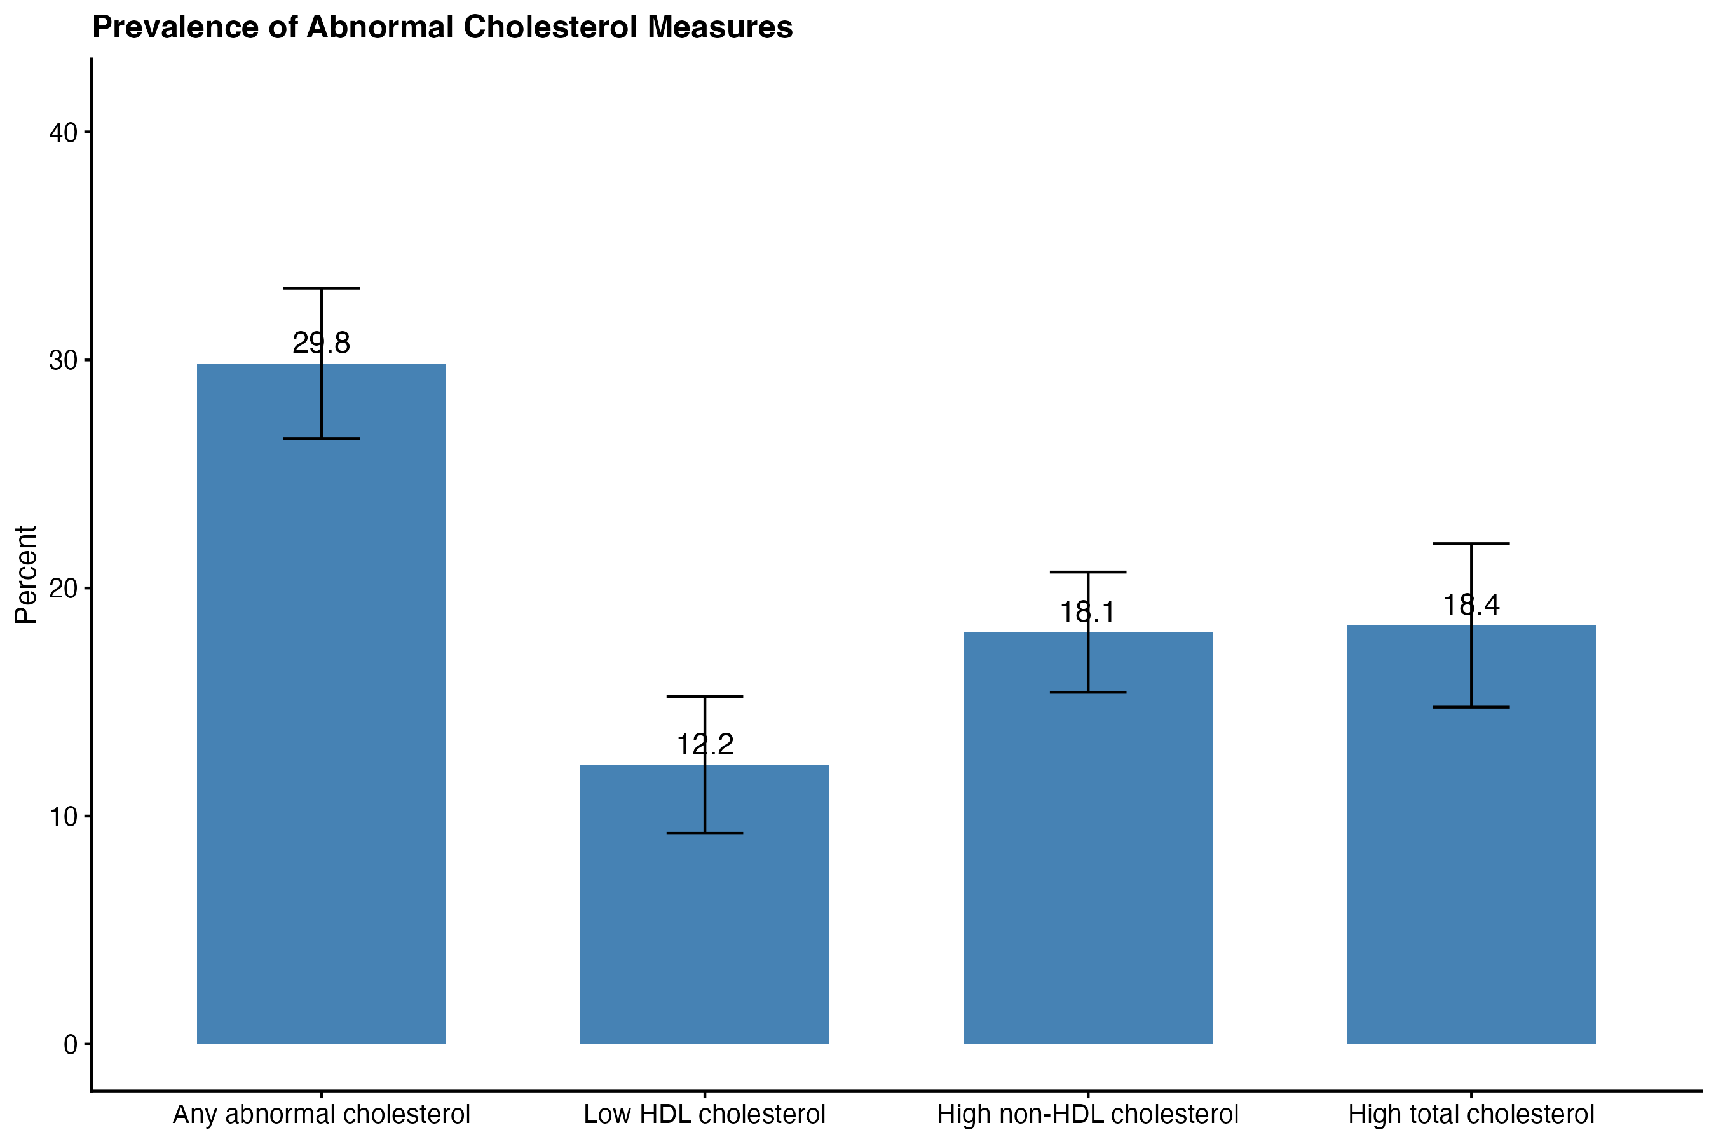
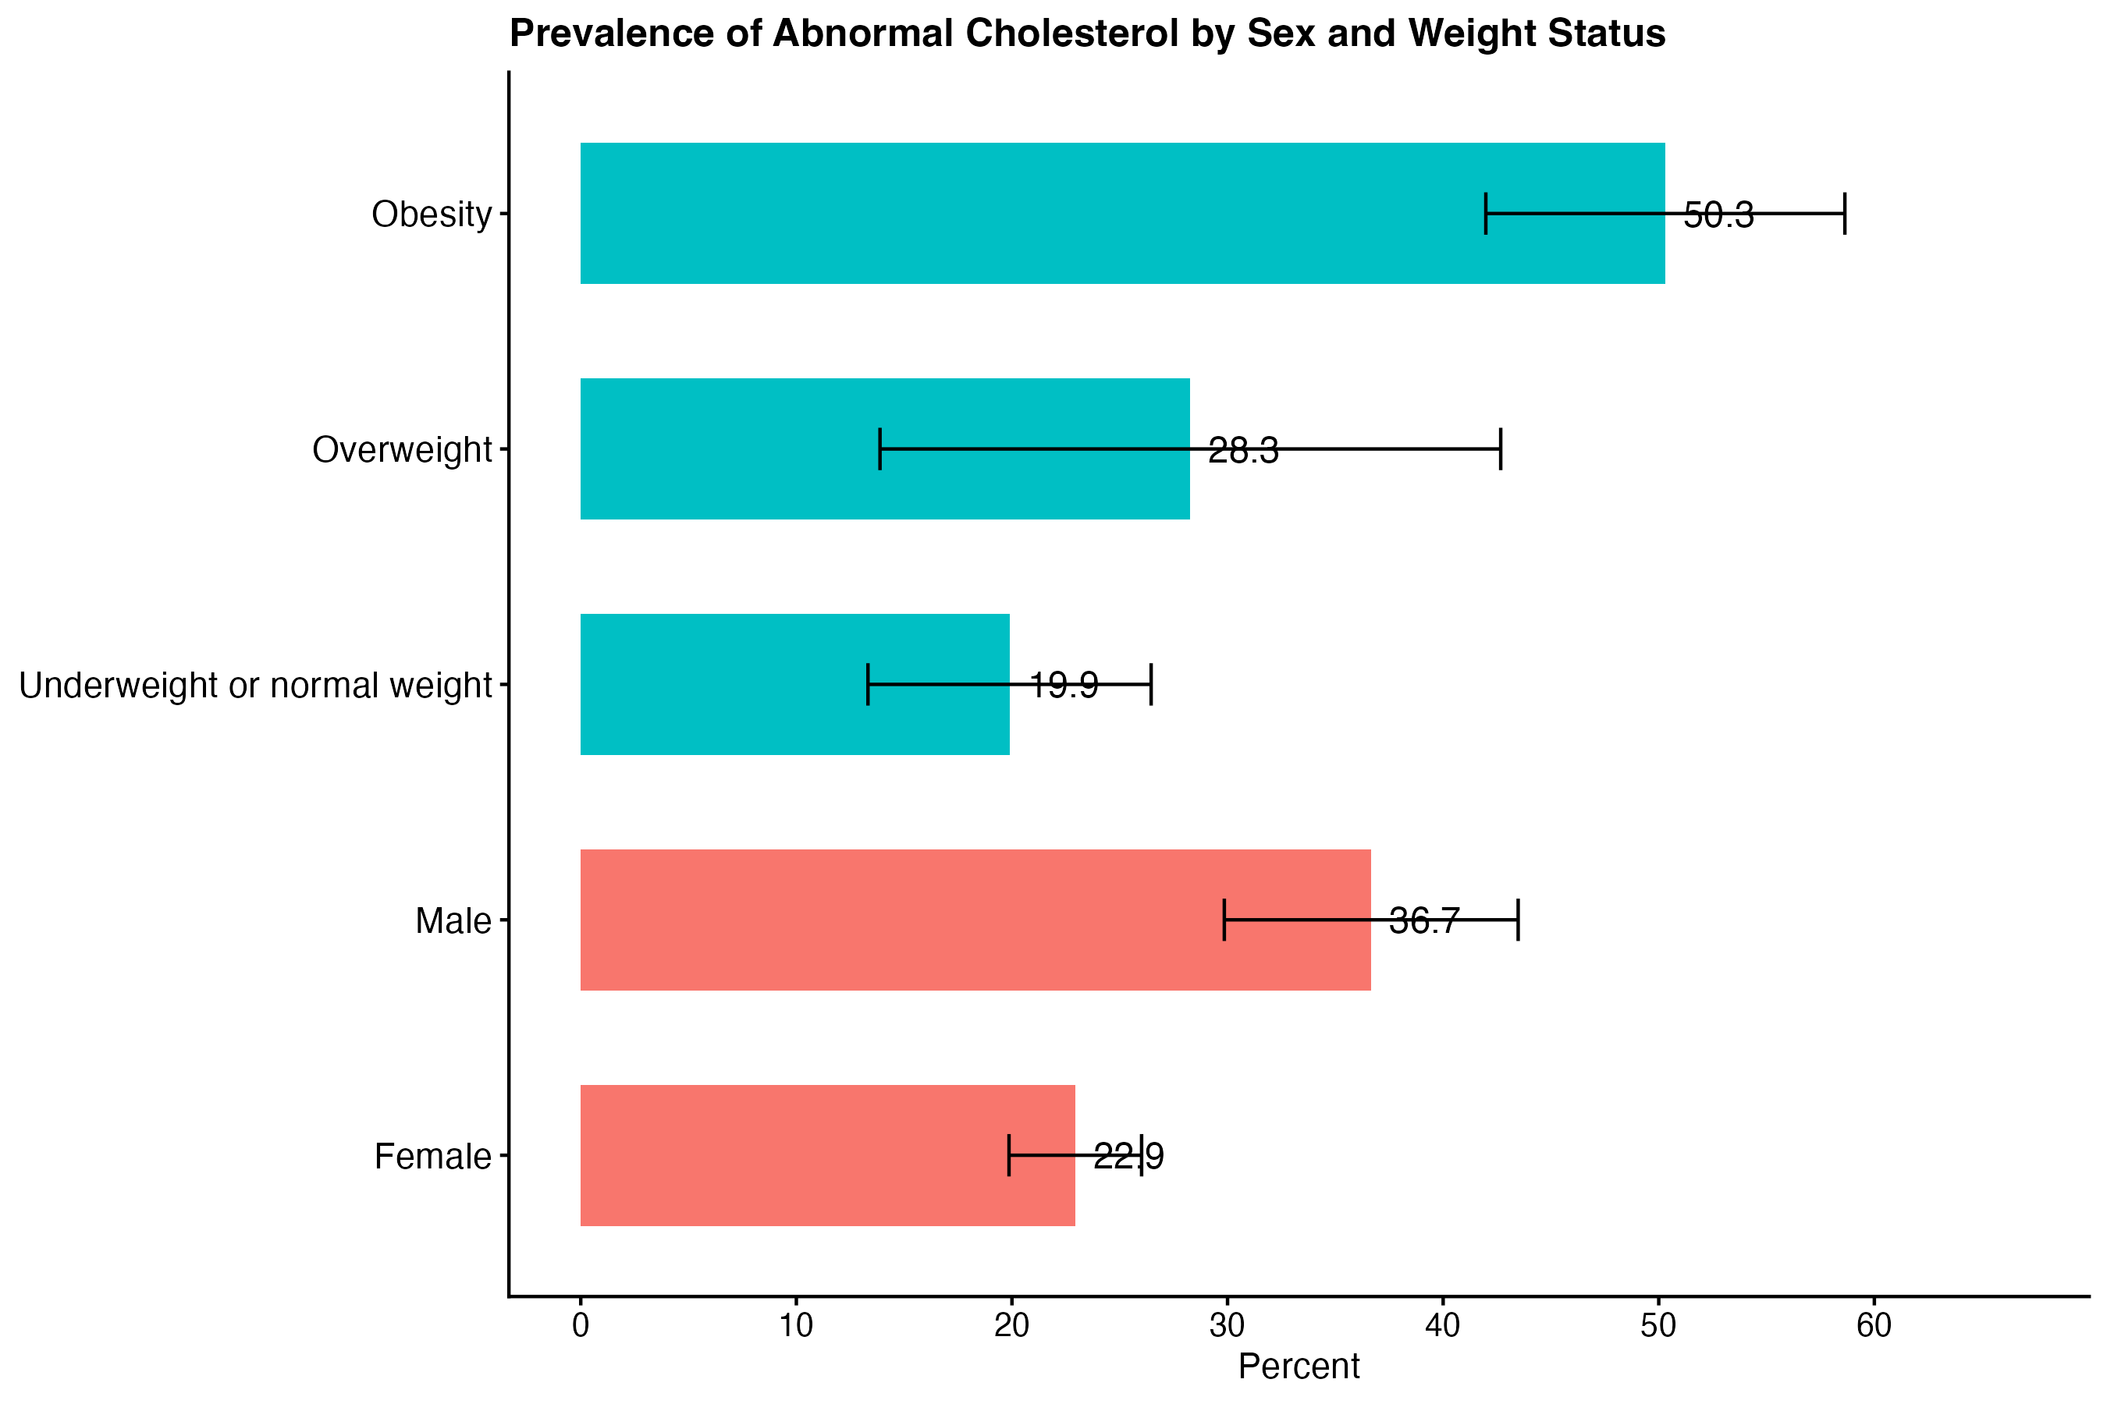
Abnormal Cholesterol in U.S. Young Adults: Behavioral Factors and Healthcare Access in Cardiovascular Risk Prevention, NHANES 2021–2023
Zhan Zhao
Master of Public Health, Epidemiology and Biostatistics
Abstract
Results1: Prevalence
Results2: Behavioral Factors
Discussion
This study examined abnormal cholesterol among U.S. young adults aged 18–26 using NHANES 2021–2023 data. Abnormal cholesterol was defined as high total cholesterol, low HDL-C, or high non-HDL-C. Survey-weighted analyses estimated prevalence by sex and weight status and explored associations with behavioral factors.
Overall abnormal cholesterol prevalence was approximately 29.8%. Males had higher prevalence than females. Prevalence was highest among participants with obesity and lowest among those with underweight or normal weight.
The findings suggest that sex and body weight status may be stronger correlates of abnormal cholesterol than the selected behavioral factors in this young adult sample. Physical activity may still be important because the association was borderline and directionally consistent with cardiovascular prevention expectations.
After adjustment, none of the selected behavioral factors reached statistical significance at p < .05.
Current smoking showed higher odds of abnormal cholesterol, but the confidence interval was wide.
Low physical activity showed a borderline association with higher odds of abnormal cholesterol.
Objectives
Conclusion
RQ1: Estimate the prevalence of abnormal cholesterol among U.S. young adults aged 18–26 by sex and weight status.
RQ2: Examine whether smoking status, binge drinking, physical activity, and sedentary behavior are associated with abnormal cholesterol after adjustment.
Model | Behavioral Factor | Adjusted OR | 95% CI | p-value
Smoking status | Former smoker vs. never smoker | 0.8 | 0.25–2.62 | 0.635
Smoking status | Current smoker vs. never smoker | 1.69 | 0.32–9.02 | 0.435
Binge drinking | Any binge drinking vs. none | 0.47 | 0.18–1.24 | 0.097
Physical activity | Below 150 min/week physical activity vs. meets guideline | 1.78 | 0.97–3.27 | 0.06
Sedentary behavior | High sedentary time vs. lower sedentary time | 1.08 | 0.58–2.01 | 0.769
Abnormal cholesterol was common among U.S. young adults aged 18–26. Males and participants with obesity showed higher risk. Behavioral factors were not statistically significant in adjusted models, but lower physical activity may warrant further investigation in larger samples.
Methods
References
Data came from NHANES August 2021–August 2023. The analytic sample was restricted to participants aged 18–26 with available cholesterol measurements. Non-HDL-C was calculated as total cholesterol minus HDL-C. Survey-weighted prevalence estimates and logistic regression models were used. Adjusted models included age, sex, race/ethnicity, and body weight status.
1. Terry, A., et al. (2024). Plan and Operations of NHANES, August 2021–August 2023. Vital Health Stat 1(66). DOI: 10.15620/cdc/151927.
2. National Center for Health Statistics. (2024). NHANES 2021–2023 Data Documentation: Cholesterol–Total (TCHOL_L).
3. Noiman, A., et al. (2026). Abnormal Cholesterol in Children and Adolescents: United States, August 2021–August 2023. NCHS Data Brief No. 552. DOI: 10.15620/cdc/174648.
4. Centers for Disease Control and Prevention. (2024). Adult BMI Categories.
5. Zou, Y., et al. (2026). Logistic regression model using LDL-C and age in NHANES data. Medicine, 105(4):e46939.
6. Espírito Santo, L.R., et al. (2022). Socioeconomic status and dyslipidemia in adults. International Health, 14(4):346–353.
Findings
Current smoker vs. never smoker: OR = 1.69, 95% CI [0.32, 9.02], p = .435
Binge drinking: OR = 0.47, 95% CI [0.18, 1.24], p = .097
Below 150 min/week physical activity: OR = 1.78, 95% CI [0.97, 3.27], p = .060
High sedentary time: OR = 1.08, 95% CI [0.58, 2.01], p = .769
Acknowledgements
Data source: National Health and Nutrition Examination Survey, National Center for Health Statistics.
Analyst: Zhan Zhao.

